Slide 1
Model-Based Neuroscience
& Cognition
Summer School
2025
Niek Stevenson

Slide 2
Mathpsych mailing list
https://mathpsych.org/page/mailing-lists

Slide 3
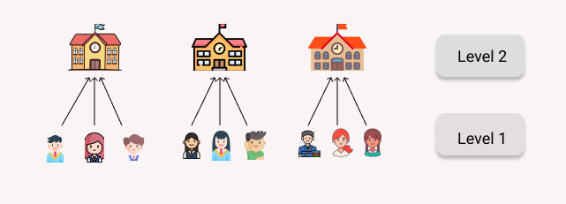
What are hierarchical models

Slide 4
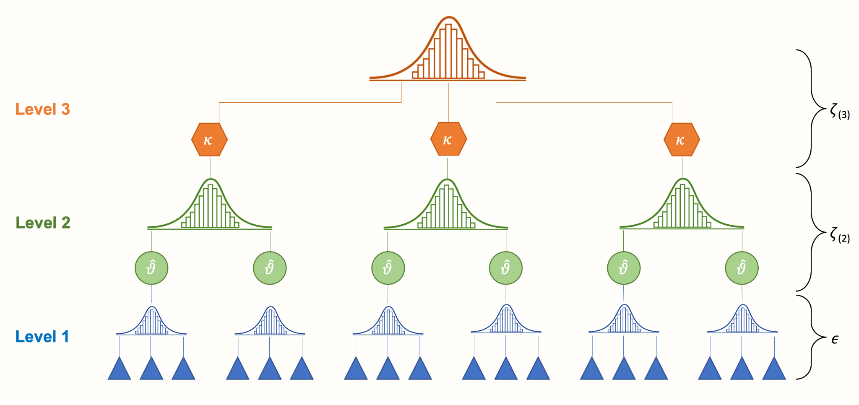
What are hierarchical models

Slide 5
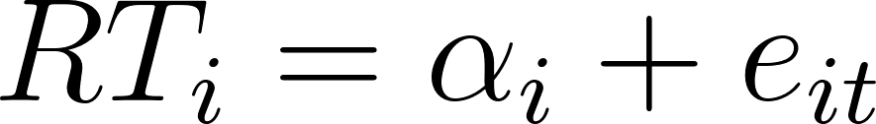
RT example
For participant i on trial t

Slide 6
RT example
For participant i on trial t
True score
Measurement error

Slide 7
Sources of measurement error
Lapses of attention
Fatigue
Motor variability
Processing variability
etc.
Hierarchical Models - Model Comparison - Cognitive Models

Slide 8
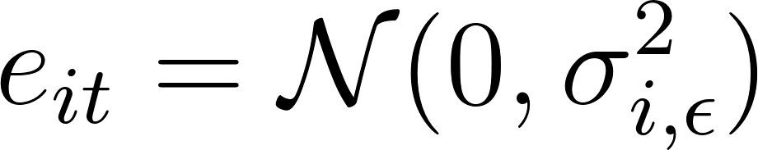
RT example
For participant i on trial t

Slide 9
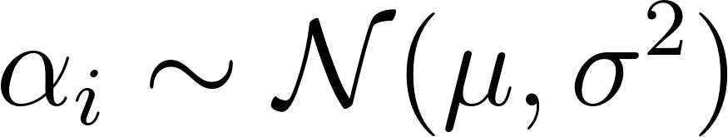
RT example
For participant i on trial t
Here α_{i} is the participant mean (true score), and μ is the group mean

Slide 10
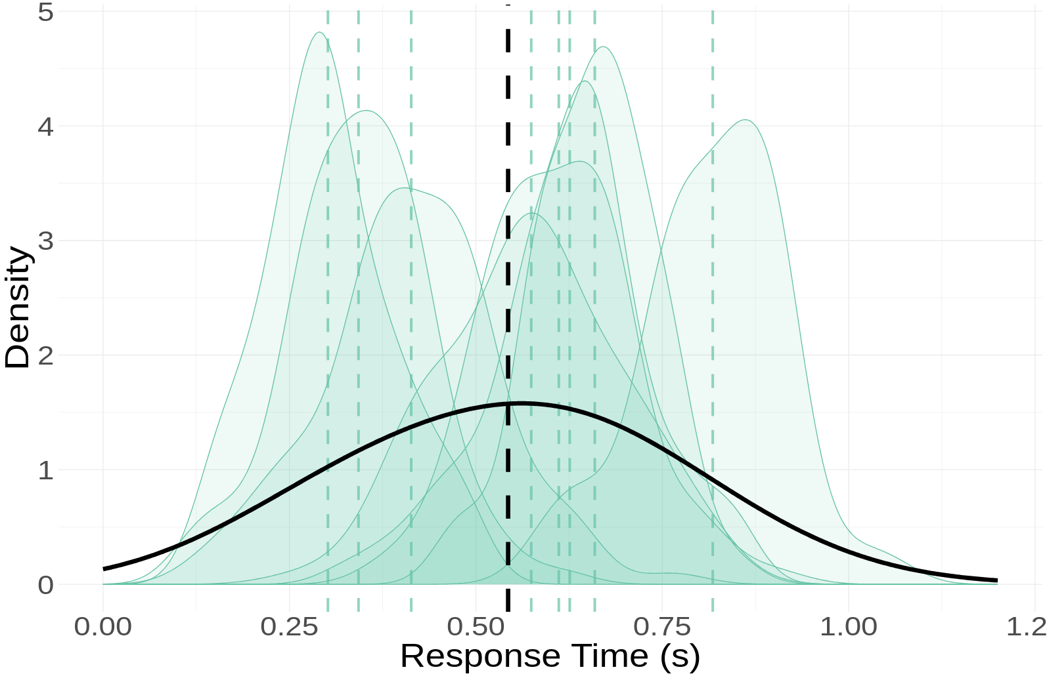

Slide 11
σ_{participant}
σ_{group}

Slide 12
Variance of the estimates
Statistics look at mean and variance of individual estimates.
Naive approach takes the mean RTs
And consequently overestimate variances

Slide 13
Variance of the estimates
Statistics look at mean and variance of individual estimates.
Naive approach takes the mean RTs
And consequently overestimate variances
With the number of trials

Slide 14
Variance of the true scores
Hierarchical model looks at true scores α_{i}
Compared to aggregated scores

Slide 15
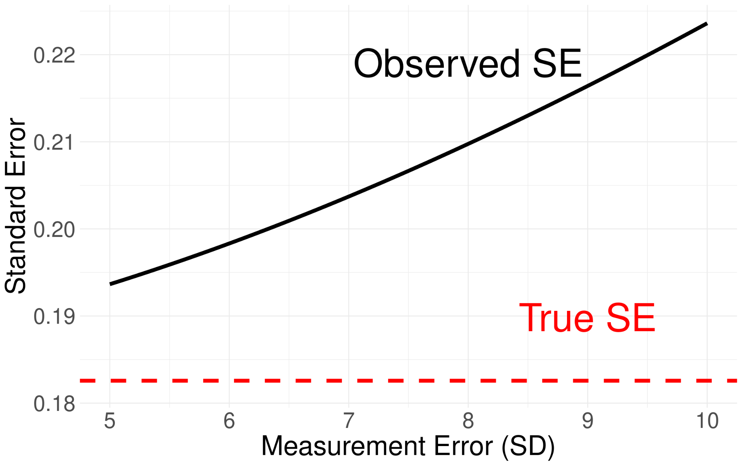
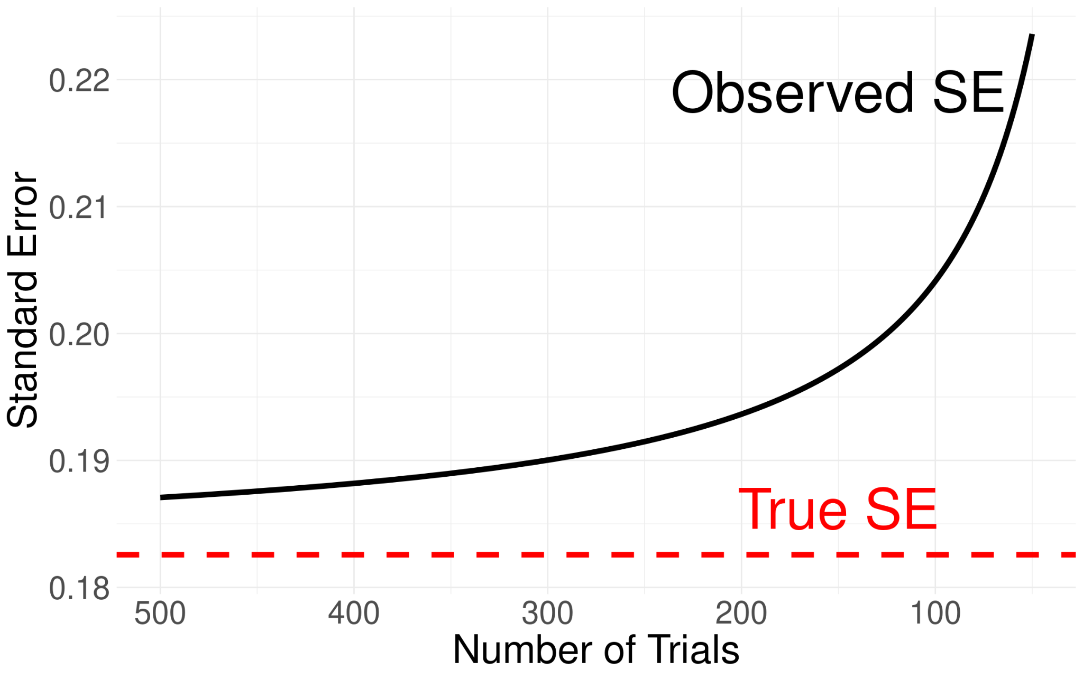

Slide 16
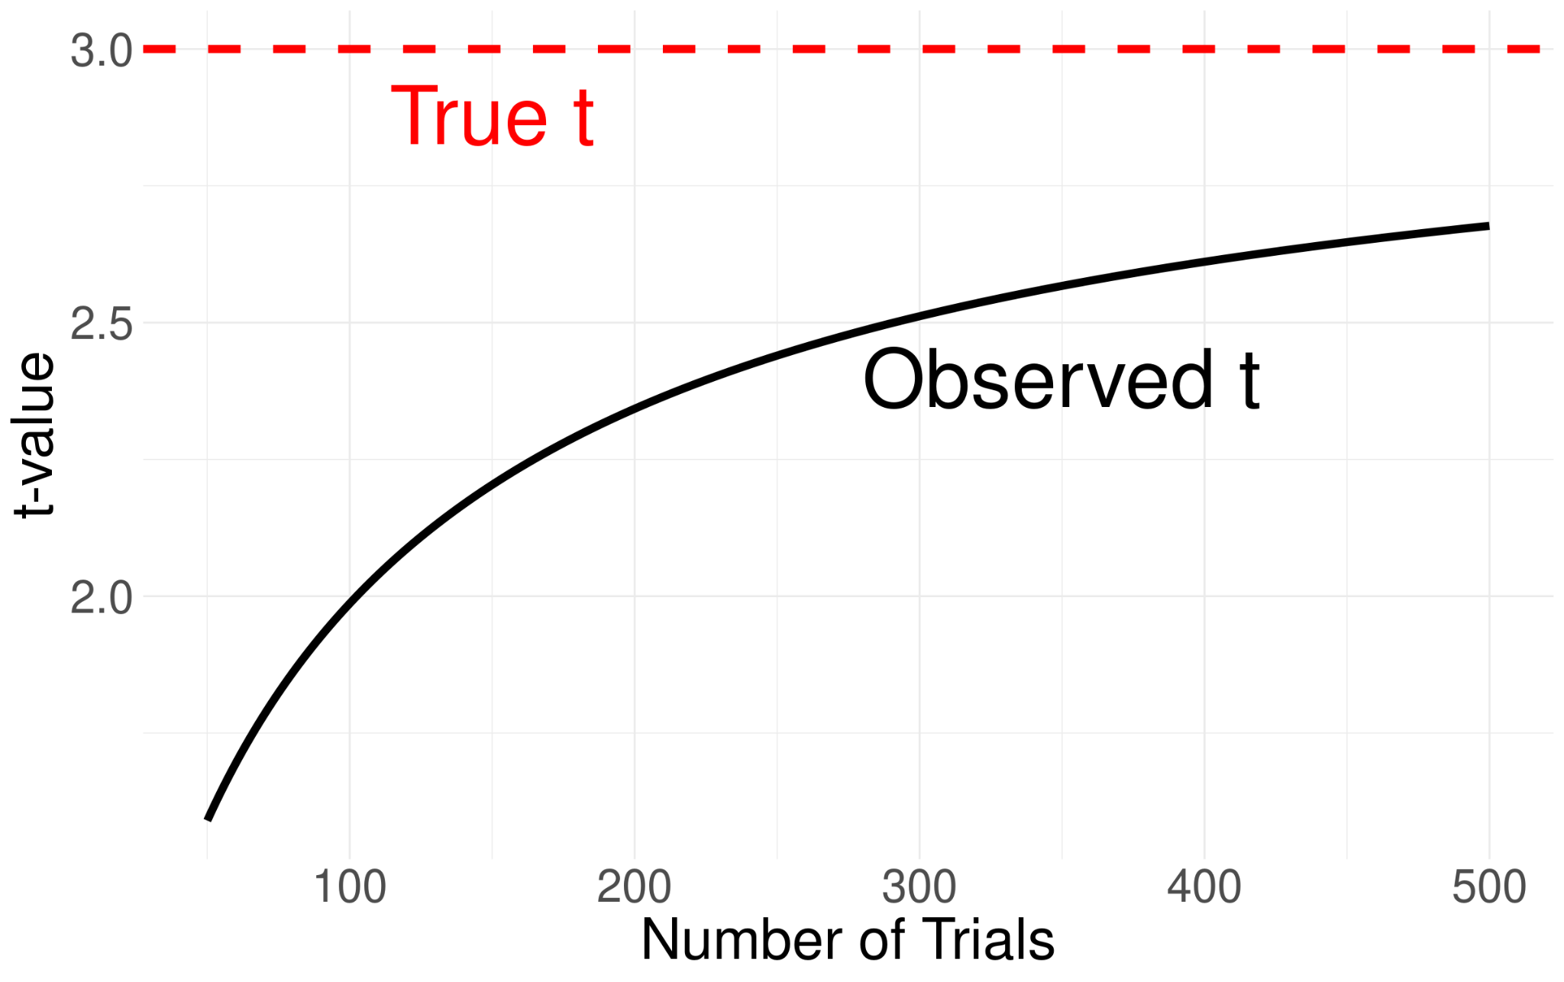
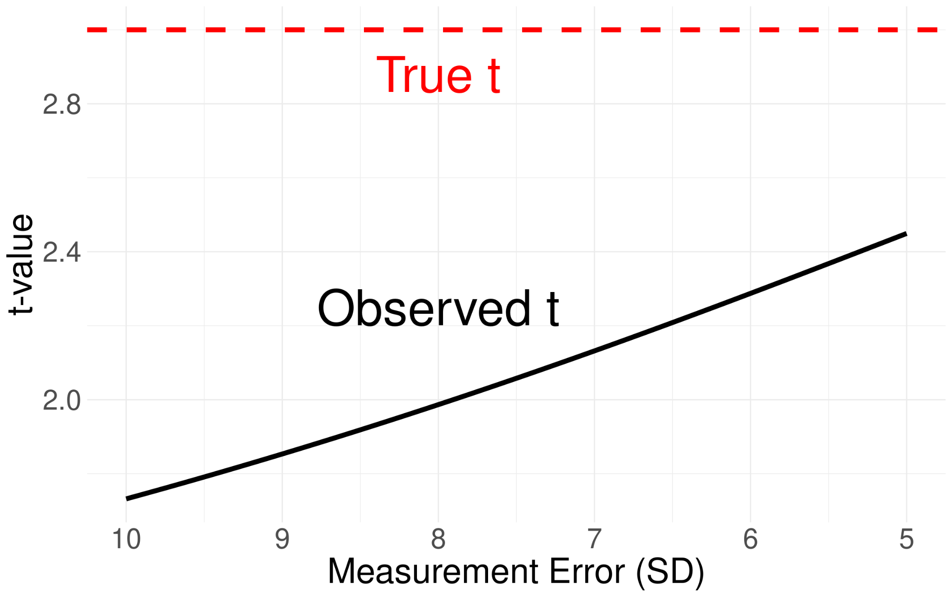

Slide 17
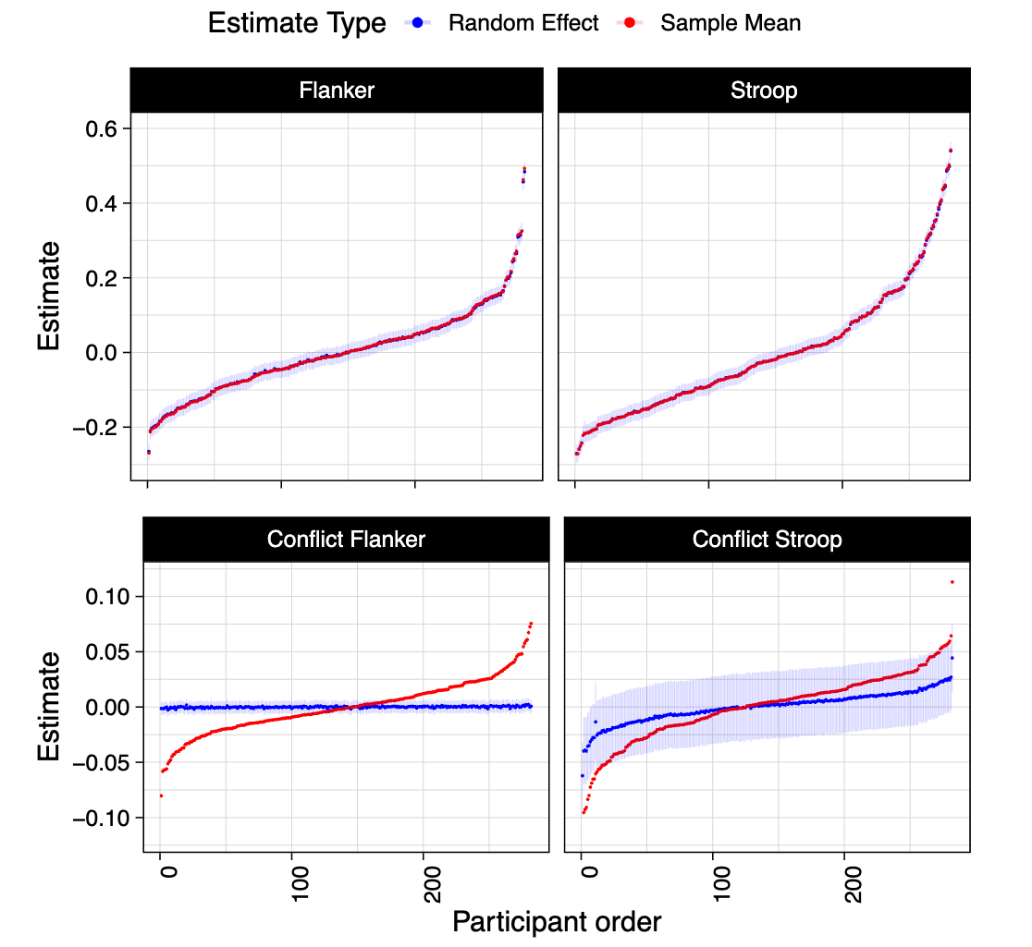

Slide 19
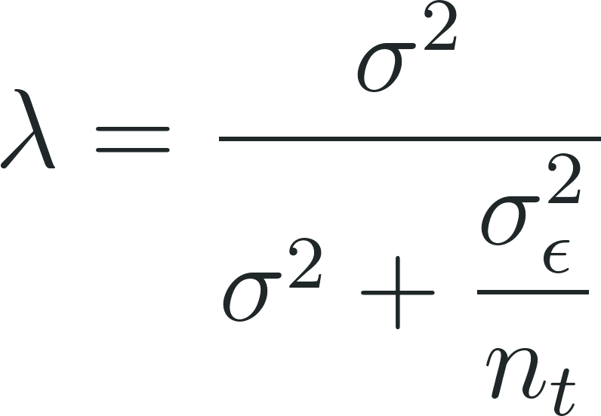
Shrinkage factor/reliability

Slide 20
Hierarchical Model
Account for uncertainty at all data-levels
Provides unbiased estimates

Slide 21
Hierarchical Model
Account for uncertainty at all data-levels
Provides unbiased estimates
However, that uncertainty is propagated to the group-level
Naive methods can be equally certain under different trial numbers
Uncertainty only based on n participants
Overconfidence

Slide 22
Cognitive models
Individual estimates also affected by measurement error
can’t be derived [unless you’re Udo]

Slide 23
Cognitive models
Individual estimates also affected by measurement error
can’t be derived [unless you’re Udo]
But still affects measurements!
You’ll still observe shrinkage in hierarchical cognitive models

